Slide 1

Question Answering System from PDFs
This presentation introduces our intelligent question answering system. It leverages Retrieval-Augmented Generation (RAG), Neo4j, and Gradio. We will discuss the project overview, team roles, and the need for efficient PDF content access. Our system offers a solution for complex information retrieval.

Slide 2
Challenges with Traditional PDF Processing
Manual Review
Lack of Structure
Reviewing PDFs is time-consuming. It is also very costly for large document sets.
PDFs lack structured data. Extracting relationships is difficult.
Keyword Search
Example
Simple keyword searches are inaccurate. They often miss critical context.
This is a problem with research papers, legal documents, and technical manuals.

Slide 3

RAG Pipeline with Neo4j
RAG (Retrieval-Augmented Generation)
Neo4j Integration
Stores structured knowledge extracted directly from PDFs.
Combines retrieval and generation techniques for enhanced answers.
Gradio Interface
Provides a user-friendly platform to ask questions.
Key technologies include Langchain, Transformers, and Neo4j.

Slide 4
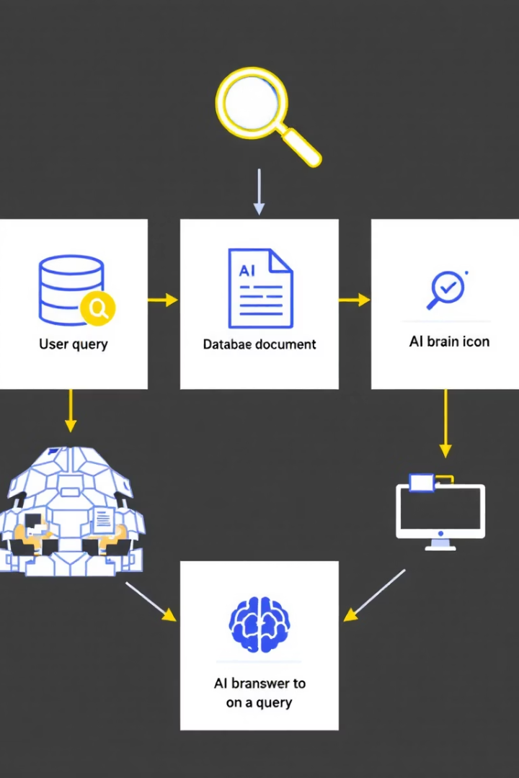




RAG Pipeline Architecture
PDF Ingestion
Load and parse PDFs using PyPDF or PDFMiner.
Chunking & Embedding
Split text and generate embeddings. Use SentenceTransformers or OpenAI.
Vector Database
Store embeddings for similarity search. Use FAISS or Chroma.
Generation
Generate answer using retrieved context. Use GPT-3.5 or Flan-T5.

Slide 5

Neo4j Knowledge Graph Construction
Entity Extraction
Relationship Extraction
Identify key entities using spaCy or NLTK.
Discover relationships between entities.
Graph Structure
Use nodes for entities and relationships for connections.
Cypher queries enable efficient data retrieval. For example, "Drug X treats Disease Y".

Slide 6




Integrating RAG with Neo4j
Hybrid Retrieval
Query Routing
1
Combine vector search with graph traversal.
Choose best retrieval method based on the question.
2
Performance Boost
4
Context Enrichment
Neo4j provides structured context for RAG.
3
Add graph context to improve answer generation.

Slide 7
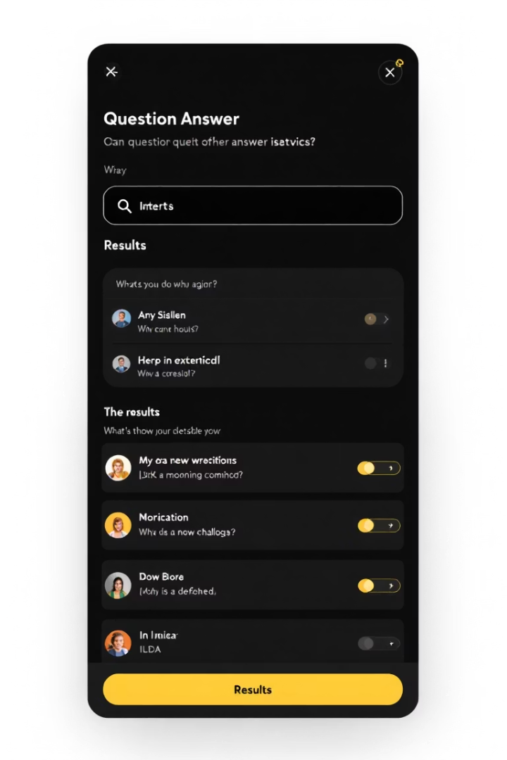




Gradio Frontend
User-Friendly
Real-Time Results
Interactive
Customizable
We have a simple question input, display of answer and source, interactive graph. The UI can be adapted to specific needs. We will now do a live demo.

Slide 8
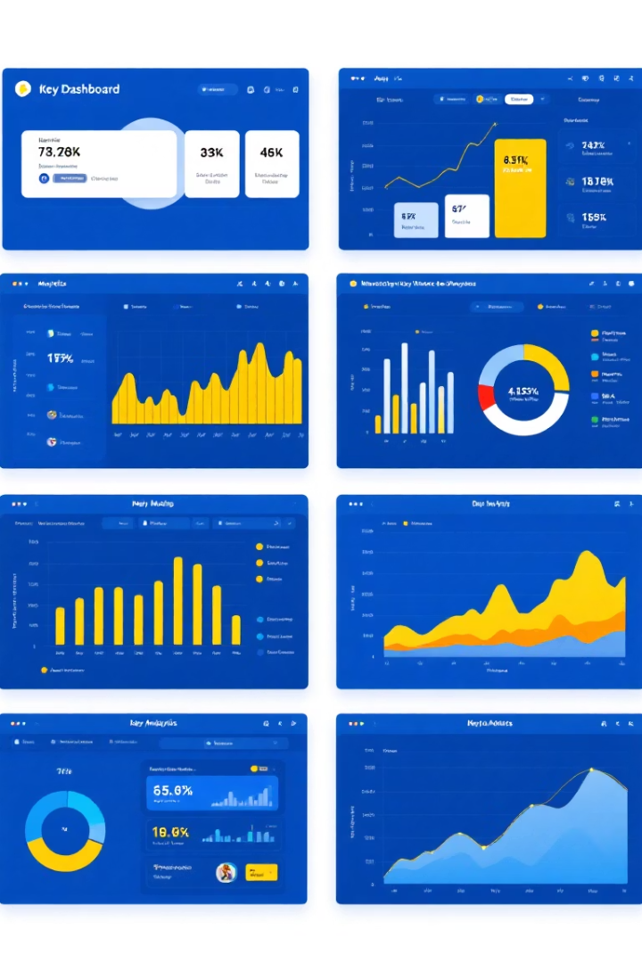
Results and Evaluation
95%
0.5s
Accuracy
Response Time
Percentage of correct answers.
Time taken to generate an answer.
8/10
User Satisfaction
Average user rating.
We compared RAG vs. RAG+Neo4j. Our results show improvement in answer quality and faster responses.

Slide 9
Challenges and Future Work
Complex Queries
1
Improve reasoning capabilities.
Scalability
2
Optimize with large knowledge graphs.
Multi-Document
3
Extend to multiple PDF sources.
We also plan to improve model accuracy with domain-specific data using fine-tuning.

Slide 10

Conclusion and Call to Action
We successfully implemented a QA system using RAG, Neo4j, and Gradio.
Future opportunities include expanding to new domains.
Commercialization is our next step.
Now, we're open for questions.

